Slide 1
Themodynamics Energy System Modelling (TESM) course
Cong Toan TRAN

Slide 2
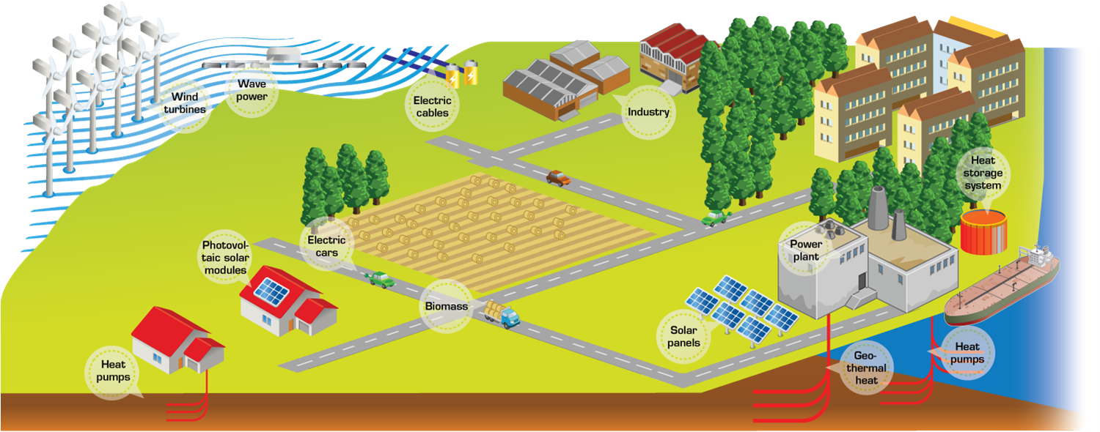
Energy systems
Energy systems are everywhere
They provide fundamental needs of the life
But, are the main greenhouse gas emitters

Slide 3
Objectives of the course
Objectives:
  Working principle of thermodynamics energy système
  Performance analysis methods
  System design
  Stationary and dynamic simulation
  Performance improvement via the exergy analysis
Cycles to be studied:
  Refrigeration and heat pumps (HVAC)
  Gaz turbine
  Water steam cycle
  Combined cycles
  Cogeneration
  + others during the project sessions

Slide 4
Planning …

Slide 5
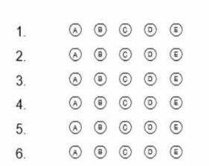


Evaluation
Multiple choice examination (/50):
  Totally based on the course’s contents
  Description of the studied thermodynamics cycles
  Comparison between ideal and real cycles
  Calculation of system efficiencies
  Exergetic analysis
  Model development in OpenModelica
  The course materials allowed during the examination
Project (/40):
  Writing report
  Simulation model
Course attendance (/10):
  Lectures
  Exercise sessions

Slide 6
Multiple choice examination
Exam on the platform Moodle
The course materials allowed
No question about OpenModelica
Evaluation:
  One question → one point, except clearly specified otherwise
  No “penalty” point for a wrong answer
How to give answers:
  If a question allows more than one answer choices, it has more than one correct answer
  If it is required to provide a numerical value, write at lease 3 significant digits
  Both the point “.” and the comma “,” can be used for a decimal sign
  You can pass a question, and come back later
  Answers can be changed, before the time runs out
Fluid property calculator: https://irc.wisc.edu/properties/

Slide 7
Course materials
Slides
Exercises
Library « EnergySystems»
And the book Thermodynamics Energy System Modelling
→ check the shared folder on Cloud

Slide 8
Thank you !
For any questions → cong-toan.tran@mines-paristech.fr

